Slide 1
Final Project for Intro to ML:
Waste Recognition & Classification
04/25/18
Group member: Zhiyang Liu, Yiwei Wang, Wandong Wu, Zilan Zhang

Slide 2
Introduction

Slide 3
Mission - Software Visual System for Waste Sorting
Image Classification
Hyperparameter Adjustment
Optimization Methods
Data Augmentation
Single Object Localization

Slide 4
Tools and Methods
Convolutional Neural Network Model
AlexNet
VGG16
11-layer Customized Net
ResNet18
Pytorch + NVIDIA GPU + Linux

Slide 5
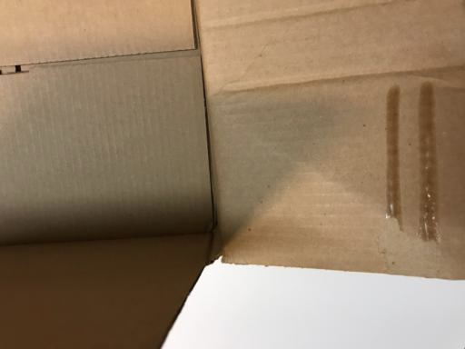
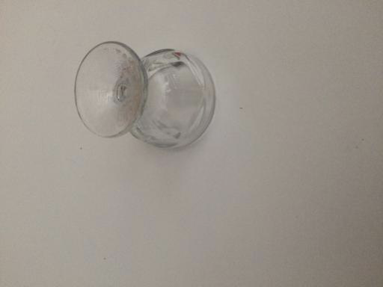
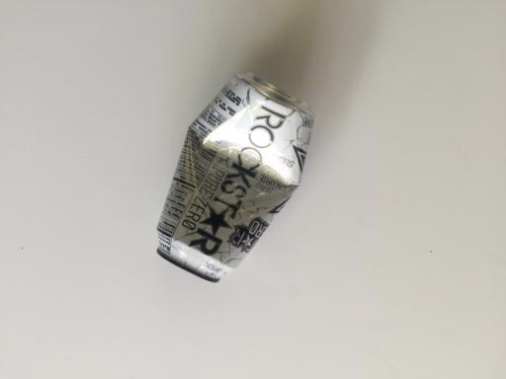
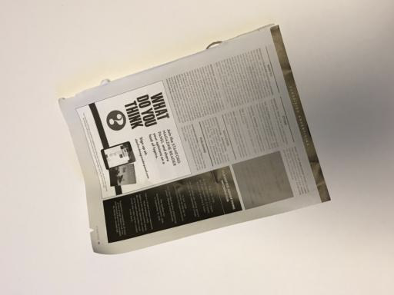
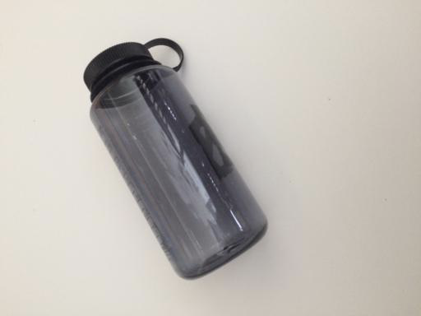
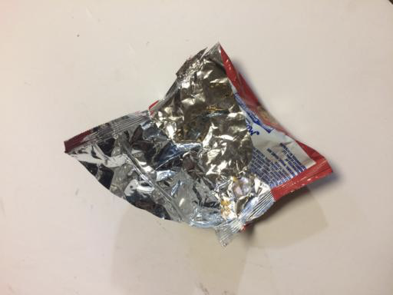
Dataset： 2527 images
cardboard: 403 glass: 501 metal: 410
paper: 594 plastic: 482 trash: 137
Source: https://github.com/garythung/trashnet

Slide 6
Hyperparameter Adjustment

Slide 7
67%
Initial Best Accuracy
^{No data augmentation}
BatchSize = 4, Learning rate = 0.001
Learning rate decay Method: torch.optim.lr_scheduler.StepLR()

Slide 8
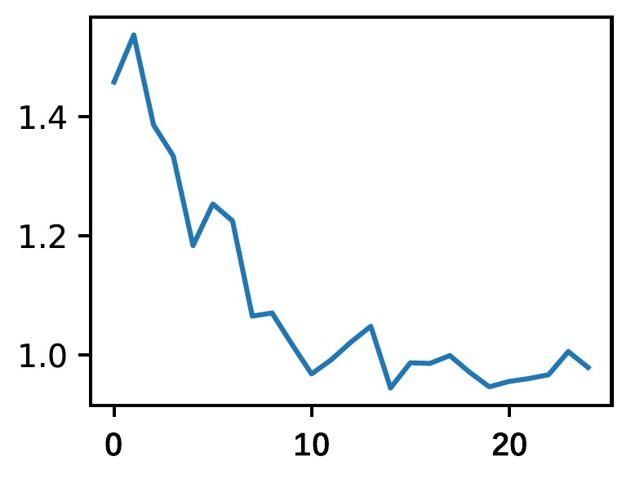
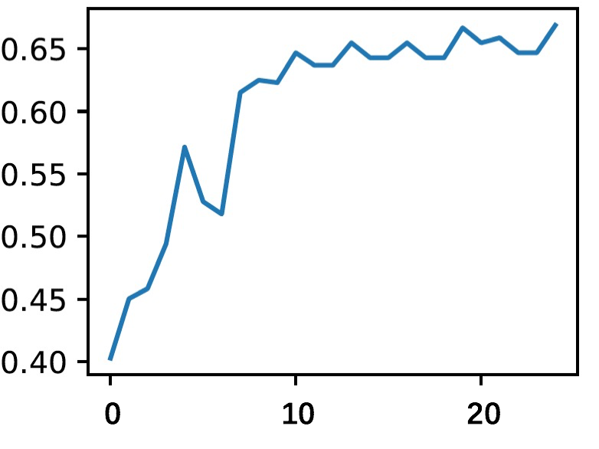
Loss Curve
Accuracy Curve

Slide 9
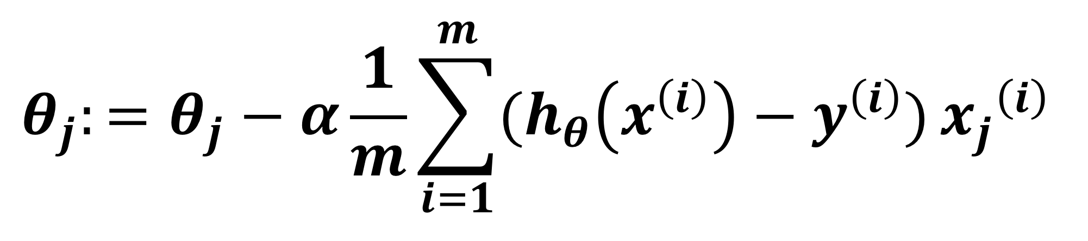
Gradient Descent Rule:
“Vanilla Gradient Descent”

Slide 10
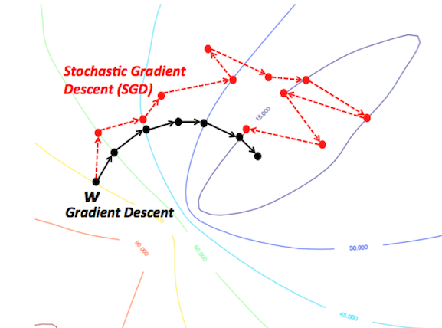
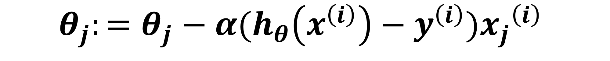
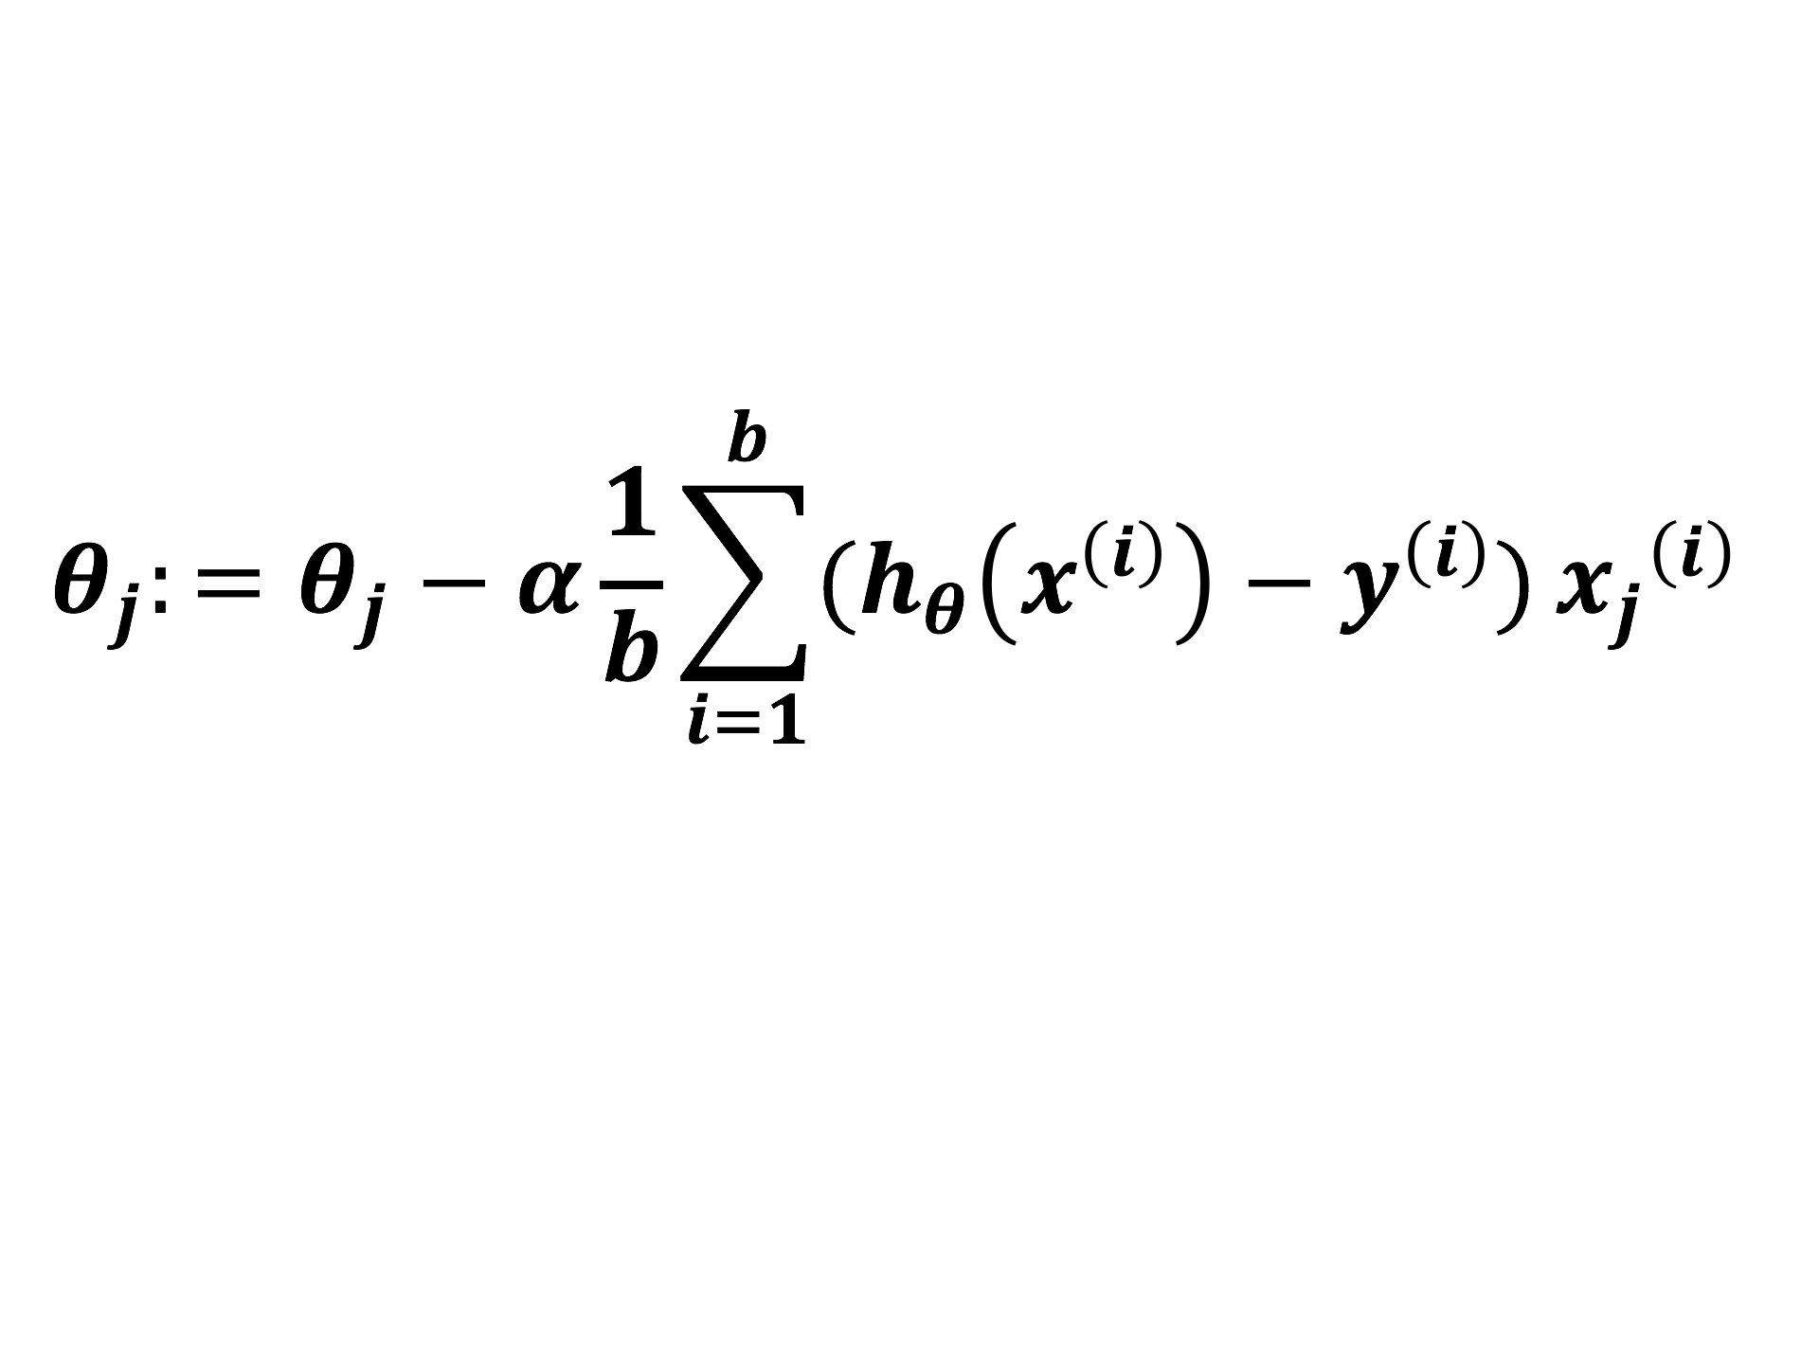
Shuffle & Stochastic Gradient Descent
Mini-batch SGD
Source: Devin Soni from Towards Data Science

Slide 11
Learning Rate:
“Dynamic Learning Rate”
Decay learning rate every 7 epochs -> Decay learning rate in an assigned range of epoch
Avoid “Vibration”

Slide 12
Optimization Methods

Slide 13
Select Optimization Method
SGD(default)
SGD+Momentum(selected)
Adaptive Optimization
Rmsprop(tested)
Adam(tested)
AdaGrad(tested)

Slide 14


Intuition of Adaptive & non-Adaptive Optimization
Saddle Point Mode
contour gradient
Source: Alec Radford

Slide 15
Optimization Method Test
SGD+Momentum
Lr = 0.001
Lr_decay_step = None
Momentum = 0.9
Adam
Lr = 0.001
Lr_decay_step = None
Betas = (0.9, 0.99)
Eps = 1e-08
Weight_decay = None
Rmsprop
Lr = 0.001
Lr_decat_step = None
Alpha = 0.99
Eps = 1e-08
Momentum = 0
AdaGrad
Lr = 0.001
Lr_decat_step = None
Weight_decay = None

Slide 16
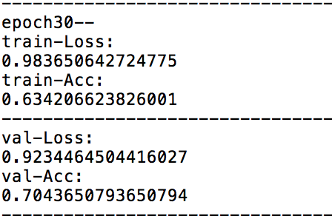
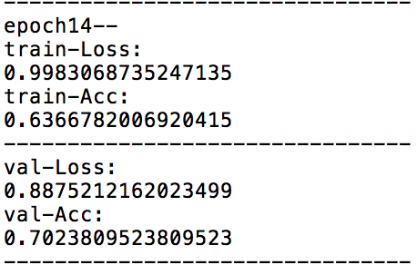
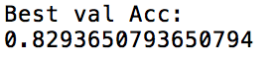
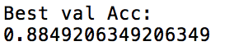
Test Record(batch_size = 64,epoch =80)
SGD+Momentum:
Adam:

Slide 17
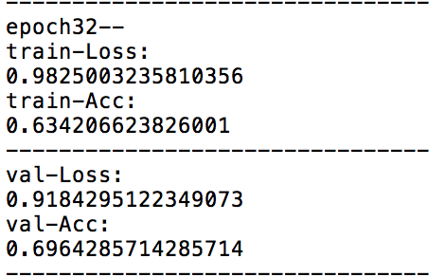
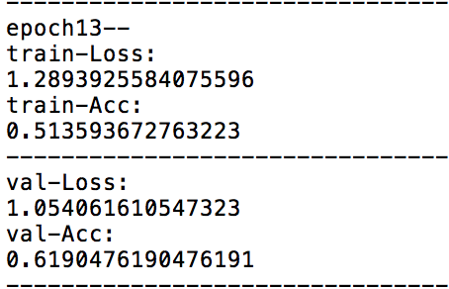
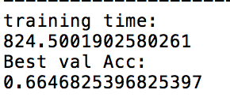
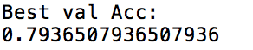
Test Record
Rmsprop:
AdaGrad(test):

Slide 18
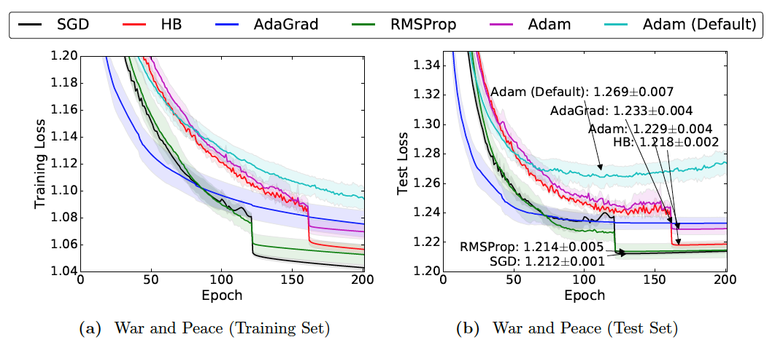
Comparison in practical
Ashia C. Wilson, R. Roelofs, M. Stern, N. Srebroy, and B. Recht. The Marginal Value of Adaptive Gradient Methods in Machine Learning. In University of California, Berkeley and Toyota Technological Institute at Chicago, May 24, 2017
Network Architecture:Torch-rnn/ Test data: War and Peace

Slide 19
Data Augmentation

Slide 20
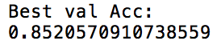
Collect more similar images from ImageNet
9000 IMAGES
2527 IMAGES
Accuracy drop !
88% 85%

Slide 21
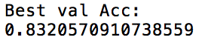
Data Augmentation
Skew, distort, rotate, shear, flip
19000 IMAGES
2527 IMAGES
Accuracy INCREASE!
88% 92%

Slide 22
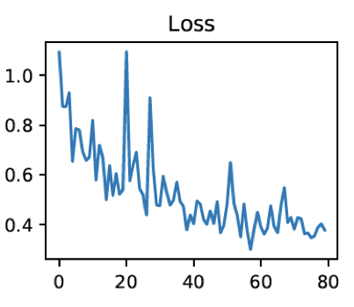
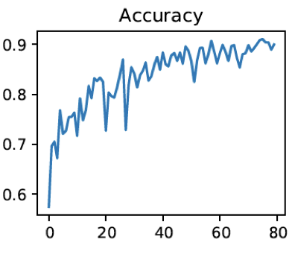
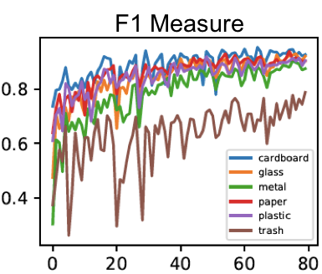
92%
Best Case Accuracy

Slide 23
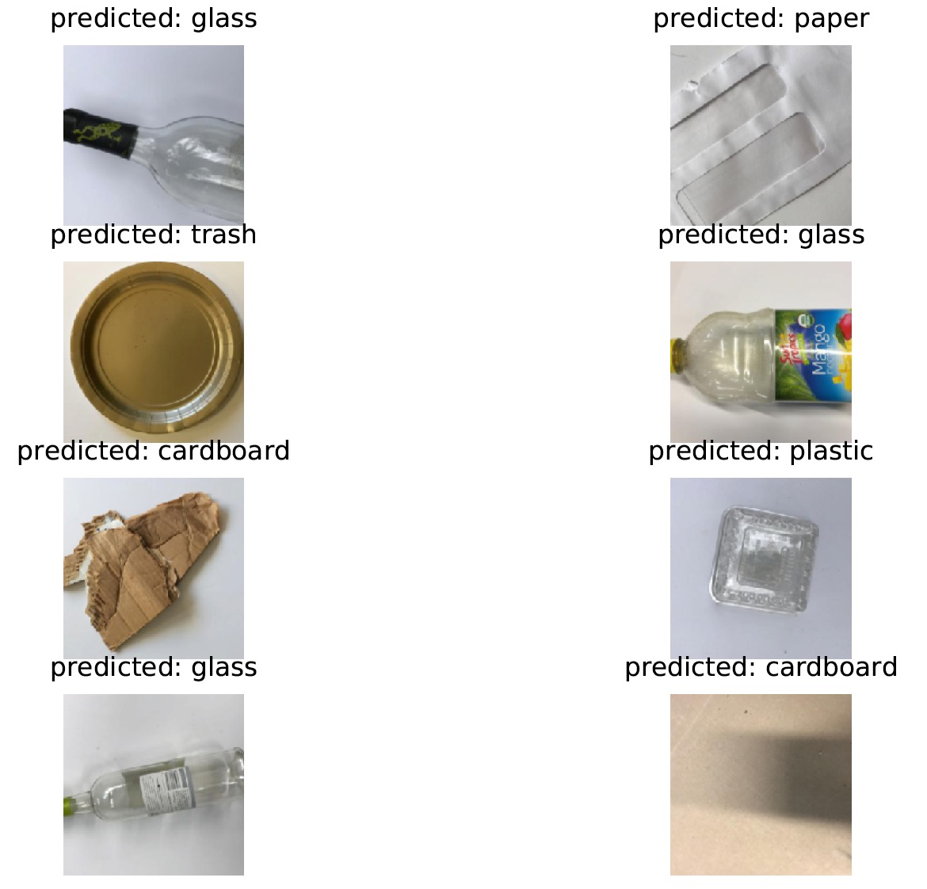

Slide 24
Object Localization

Slide 25
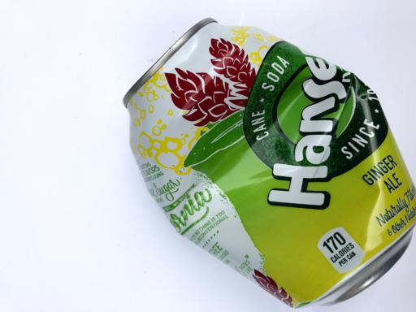
Object Localization Model
Fully Connected layer
Convolutional and Pooling
Classification
Cross Entropy
Loss
Class scores
…
Loss
Regression
Box coordinates
L2 Loss
Notes:
Two output, use loss and bp
Bbox preprocessing, normalization, (corresponding to data augmentation)
Loss: IoU and L2

Slide 26
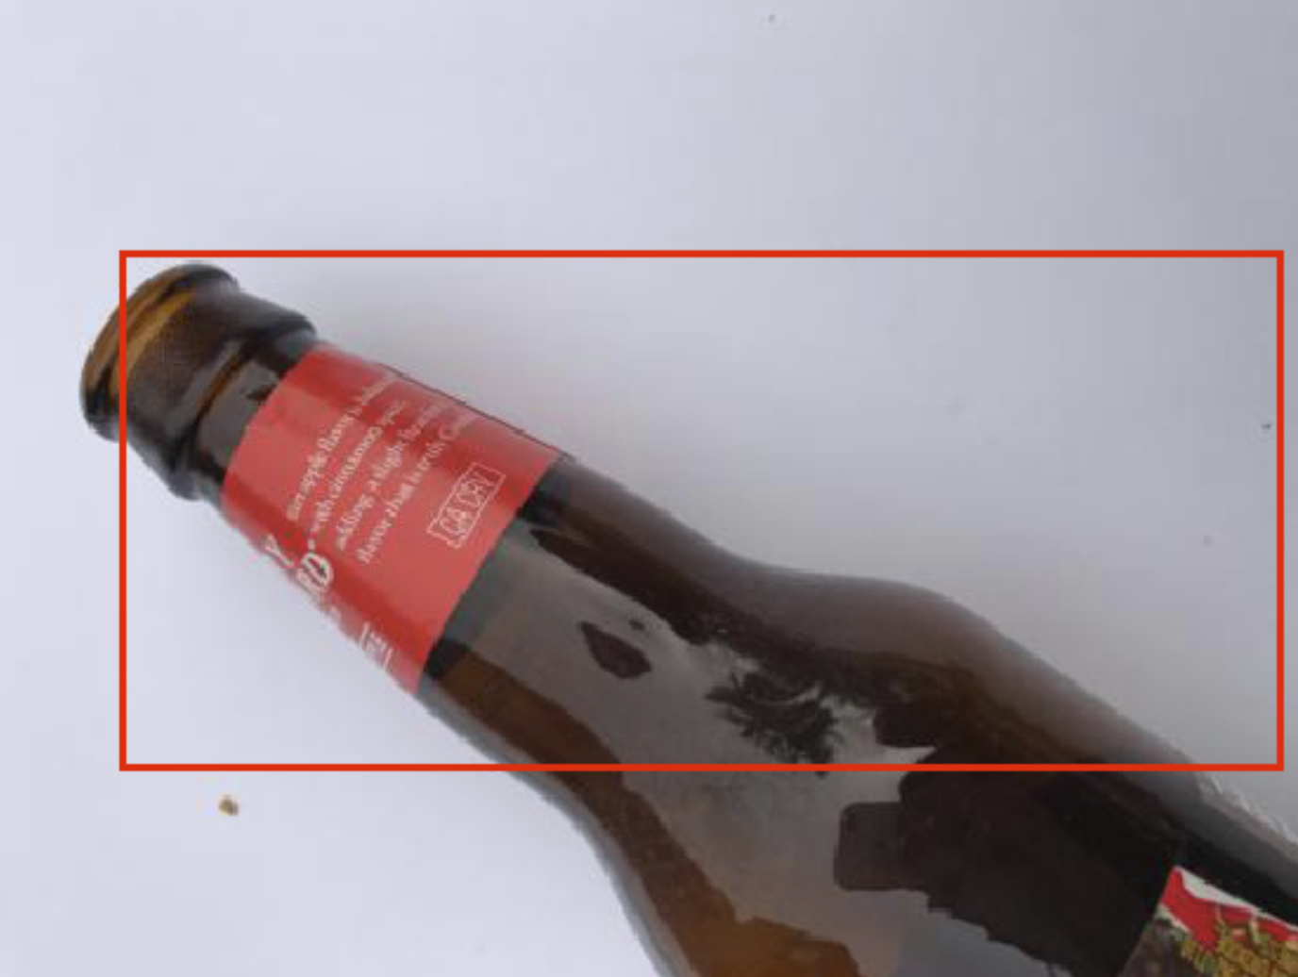
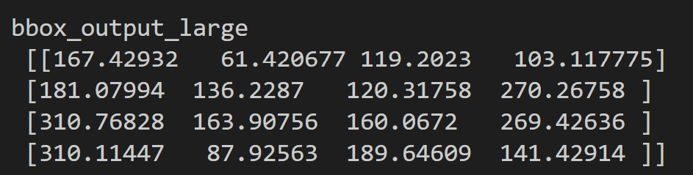
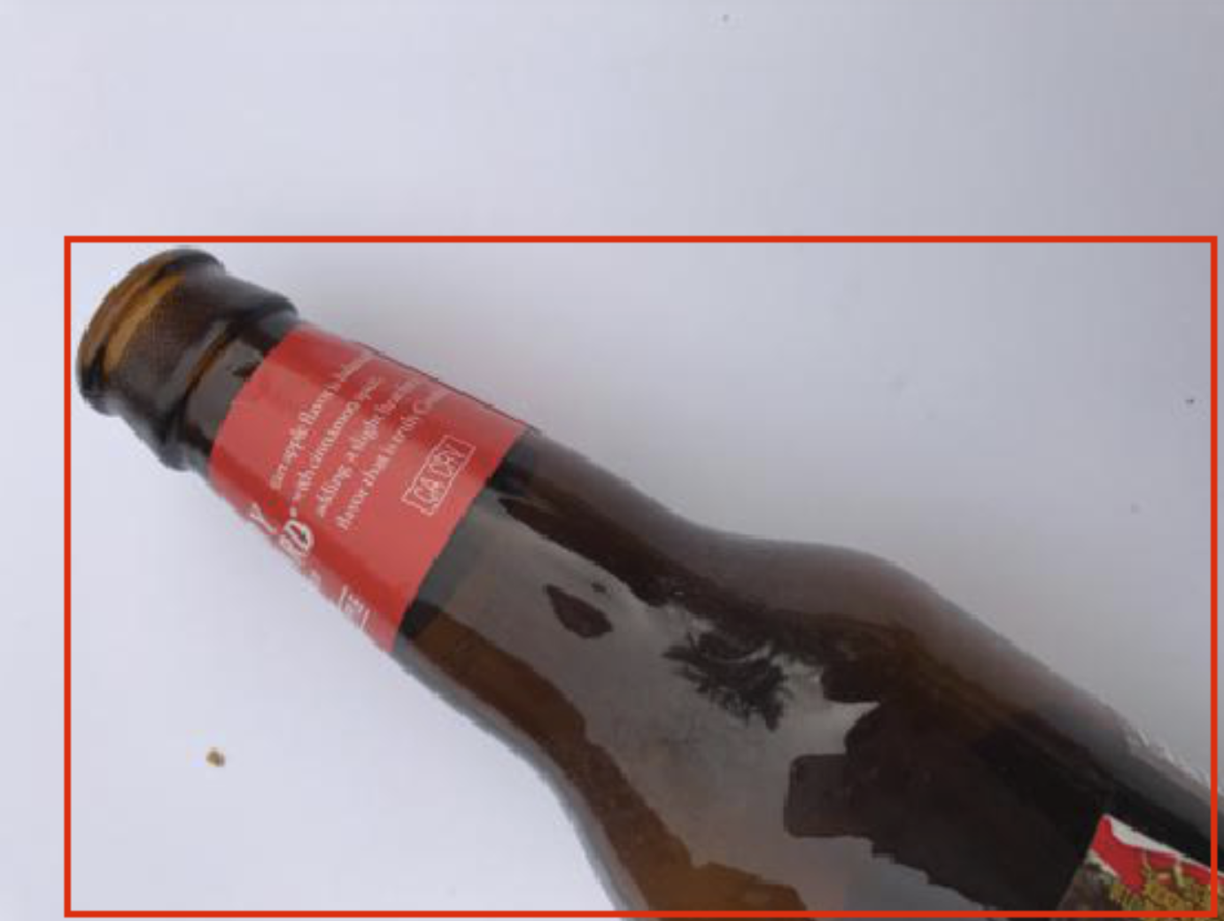
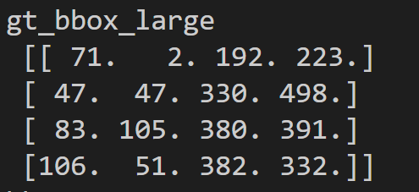
Localization result
Decent one
Bad Result
Output
Output
Ground truth
Ground truth
Notes:
Low accuracy

Slide 27
Future Work
Multiple Object detection
Faster R-CNN
Instance Segmentation
Mask R-CNN
Data acquisition
Web App, launch a Facebook topic

Slide 28
Thank You!

